Slide 1
Greening the Spark # ONE LINE AT A TIME a hands-on model for museums
Presentation for BrightonPy
Silicon Brighton
by Carl Nicholson
8th February 2024
Notes:
This template can be used as a starter file for presenting training materials in a group setting.
Sections
Right-click on a slide to add sections. Sections can help to organize your slides or facilitate collaboration between multiple authors.
Notes
Use the Notes section for delivery notes or to provide additional details for the audience. View these notes in Presentation View during your presentation.
Keep in mind the font size (important for accessibility, visibility, videotaping, and online production)
Coordinated colors
Pay particular attention to the graphs, charts, and text boxes.
Consider that attendees will print in black and white or grayscale. Run a test print to make sure your colors work when printed in pure black and white and grayscale.
Graphics, tables, and graphs
Keep it simple: If possible, use consistent, non-distracting styles and colors.
Label all graphs and tables.

Slide 2
Career Summary
Electronics technician (Oxford University research lab)
Feasibility study Advanced Robotics Initiative (WP manager operations concept & computer system - first AI 1989)
Leisure: founder and technical director Cyberdrome Enterprises; 8 Crystal Mazes (5 UK, 2 Japan, 1 Dubai)
Space Operations: system engineer, simulator of the ISS Columbus module for astronaut and operations personnel training (Munich)
Galileo GPS: 4 years, quit & early retirement, returned to UK
Climate change + electronics + mathematical modelling + programming + graphics + sound -> Greening the Spark (2021)
Notes:
Give a brief overview of the presentation. Describe the major focus of the presentation and why it is important.
Introduce each of the major topics.
To provide a road map for the audience, you can repeat this Overview slide throughout the presentation, highlighting the particular topic you will discuss next.

Slide 3
Introduction
“Greening the Spark” (GTS) is a hands-on model of a National Grid, a system for electricity
Generation
Distribution
Storage and
Consumption
for promoting awareness of electrical energy as a vital part of our economy and the impact it can have on the environment.
It has been developed as a prototype for a:
Museum exhibit and hands-on game for kids and adults alike
Teaching aid for use in schools and universities.
Notes:
Give a brief overview of the presentation. Describe the major focus of the presentation and why it is important.
Introduce each of the major topics.
To provide a road map for the audience, you can repeat this Overview slide throughout the presentation, highlighting the particular topic you will discuss next.

Slide 4
Implementation
Software:
The models were developed in a Python 3.7 on a PC running Windows 10.
The target environment is a Raspberry Pi 4B, running Raspbian GNU/Linux 10 (buster), operated remotely from a PC or mobile device. Python IDE is Thonny 3.3.3.
Code: approximately 10,000 lines of Python, excluding third party software and test programs.
Hardware:
Visitor & staff control panels
Grid Monitoring and Control System panel
Dynamic representations of wind and solar farms
Themed landscape & signage to provide context and information
Notes:
Give a brief overview of the presentation. Describe the major focus of the presentation and why it is important.
Introduce each of the major topics.
To provide a road map for the audience, you can repeat this Overview slide throughout the presentation, highlighting the particular topic you will discuss next.

Slide 5
Part I
Greening the Spark
The Museum Installation
Notes:
Give a brief overview of the presentation. Describe the major focus of the presentation and why it is important.
Introduce each of the major topics.
To provide a road map for the audience, you can repeat this Overview slide throughout the presentation, highlighting the particular topic you will discuss next.

Slide 6
Infrastructure
The following infrastructure elements of a typical national electricity grid are modelled in software:
Wind power
Solar power
Fossil fuels power
Nuclear power
Battery storage
Pumped hydroelectric storage
Grid monitoring and control system
Notes:
Give a brief overview of the presentation. Describe the major focus of the presentation and why it is important.
Introduce each of the major topics.
To provide a road map for the audience, you can repeat this Overview slide throughout the presentation, highlighting the particular topic you will discuss next.

Slide 7
The models
Scenarios are presented as predefined models of:
Weather (wind, sun) and
Consumer demand
Randomisation & bursts
Forecasts are provided for each scenario.
Fossil fuels and nuclear power generation are
under operator control (game mode) or
autonomously by a Non-Renewables Management System (exhibit mode).
Storage elements are autonomous and controlled by a Storage Management System.
Overall management of the grid is provided by the Grid Monitoring and Control System, based on spacecraft M&C
Notes:
Give a brief overview of the presentation. Describe the major focus of the presentation and why it is important.
Introduce each of the major topics.
To provide a road map for the audience, you can repeat this Overview slide throughout the presentation, highlighting the particular topic you will discuss next.

Slide 8
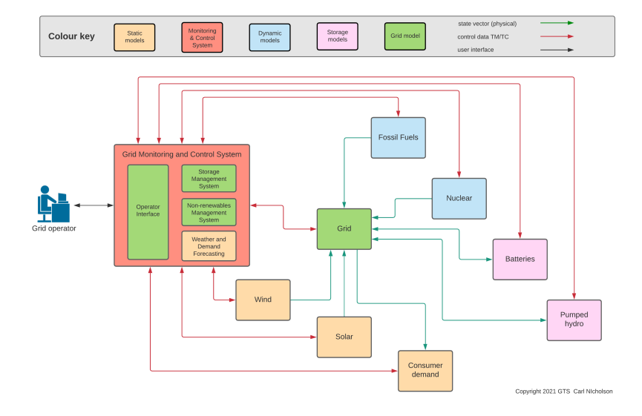
The Grid – Power & Control
Notes:
Give a brief overview of the presentation. Describe the major focus of the presentation and why it is important.
Introduce each of the major topics.
To provide a road map for the audience, you can repeat this Overview slide throughout the presentation, highlighting the particular topic you will discuss next.

Slide 9
Grid Monitoring and Control
At the heart of the GTS is the Grid Monitoring and Control System which manages the grid and connected elements, providing the following functions:
Reception of telemetry from grid elements containing power, energy and status information
Operator interface for manual monitoring and control via a control panel
Grid control laws for determining how power is allocated to / from the grid elements, implemented as:
Non-renewables Management System for controlling the power generated by the fossil fuels and nuclear power stations
Storage Management System determining when and where energy is to be stored / retrieved
Telecommand system for transmitting control information to each element
Calculation of derived data, such as cumulative energy, utilisation, CO₂ footprint and costs
Generation and collection of data for game results display, further inspection and analysis
Notes:
Give a brief overview of the presentation. Describe the major focus of the presentation and why it is important.
Introduce each of the major topics.
To provide a road map for the audience, you can repeat this Overview slide throughout the presentation, highlighting the particular topic you will discuss next.

Slide 10
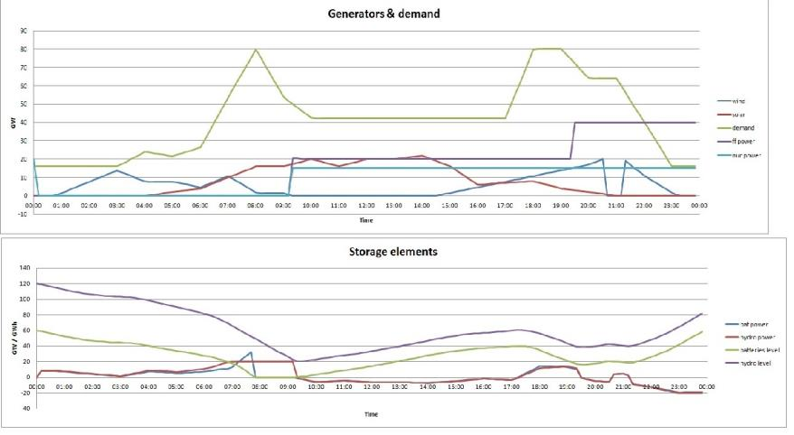
Example scenario
Notes:
Give a brief overview of the presentation. Describe the major focus of the presentation and why it is important.
Introduce each of the major topics.
To provide a road map for the audience, you can repeat this Overview slide throughout the presentation, highlighting the particular topic you will discuss next.

Slide 11
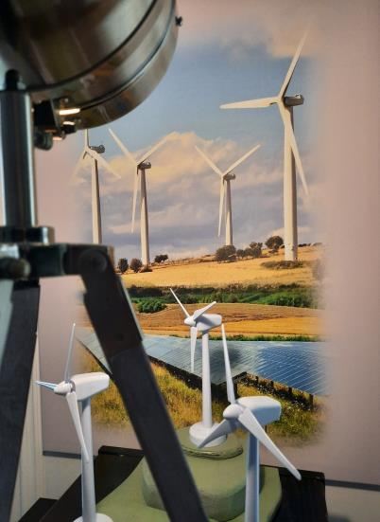
Representations
Sun lamp
Background wind and solar farm
Model wind turbines
Notes:
Give a brief overview of the presentation. Describe the major focus of the presentation and why it is important.
Introduce each of the major topics.
To provide a road map for the audience, you can repeat this Overview slide throughout the presentation, highlighting the particular topic you will discuss next.

Slide 12
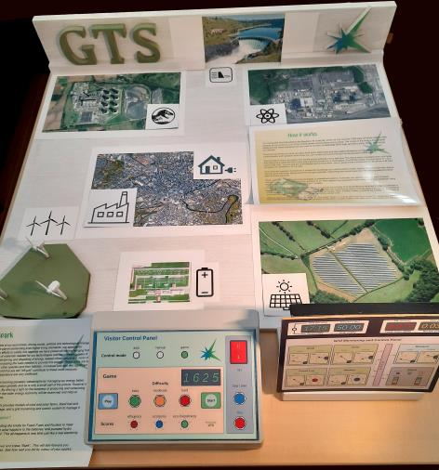
Layout and theming
Pumped hydro electric storage
Fossil fuels power station
Nuclear power station
Consumer demand
Signage
Fossil fuels power station
Solar farm
Battery storage
Operator control panel
Staff and visitor control panels
Notes:
Give a brief overview of the presentation. Describe the major focus of the presentation and why it is important.
Introduce each of the major topics.
To provide a road map for the audience, you can repeat this Overview slide throughout the presentation, highlighting the particular topic you will discuss next.

Slide 13
The experience
Visitor experience:
Exhibit mode:
Real time autonomous operation (SMS, NRMS)
Infra red trip
Game mode:
24 hours of game time in 5 minutes
3 difficulty levels
“Sparks” are awarded for performance
Results posted to online database
Audio provides:
Sound effects
Background soundscape
Three “characters” to inform and entertain
Staff experience:
Switch on and off via the staff control panel
Automatic self-tests allow for easy checking and troubleshooting
Can be accessed via a laptop
Notes:
Give a brief overview of the presentation. Describe the major focus of the presentation and why it is important.
Introduce each of the major topics.
To provide a road map for the audience, you can repeat this Overview slide throughout the presentation, highlighting the particular topic you will discuss next.

Slide 14
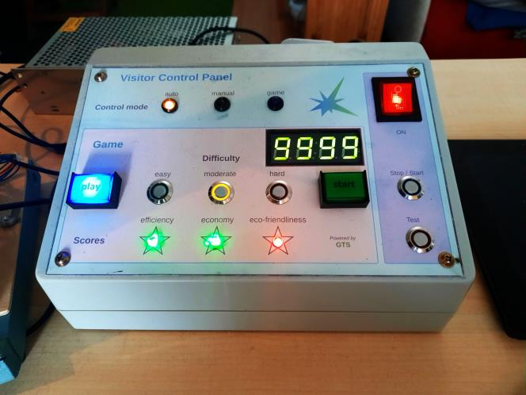
Visitor & staff control panels
Visitor Control Panel
Staff control panel
Game number
Game controls & info
Sparks awarded
Notes:
Give a brief overview of the presentation. Describe the major focus of the presentation and why it is important.
Introduce each of the major topics.
To provide a road map for the audience, you can repeat this Overview slide throughout the presentation, highlighting the particular topic you will discuss next.

Slide 15
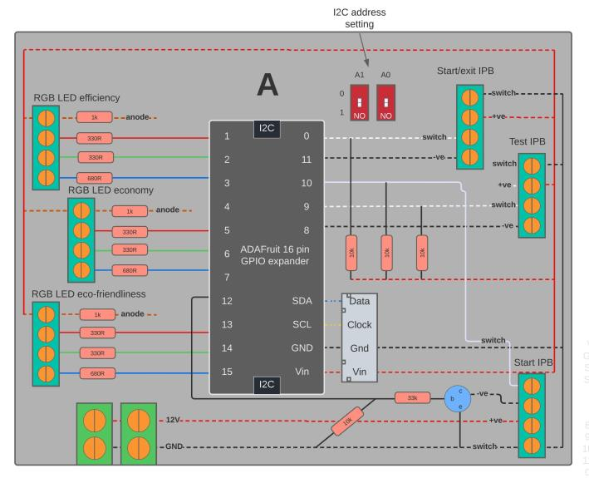
Control panel i/f schematic
Notes:
Give a brief overview of the presentation. Describe the major focus of the presentation and why it is important.
Introduce each of the major topics.
To provide a road map for the audience, you can repeat this Overview slide throughout the presentation, highlighting the particular topic you will discuss next.

Slide 16
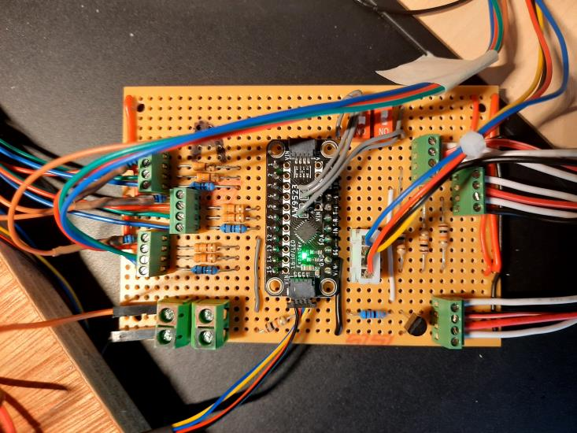
Control panel i/f actual
Notes:
Give a brief overview of the presentation. Describe the major focus of the presentation and why it is important.
Introduce each of the major topics.
To provide a road map for the audience, you can repeat this Overview slide throughout the presentation, highlighting the particular topic you will discuss next.

Slide 17
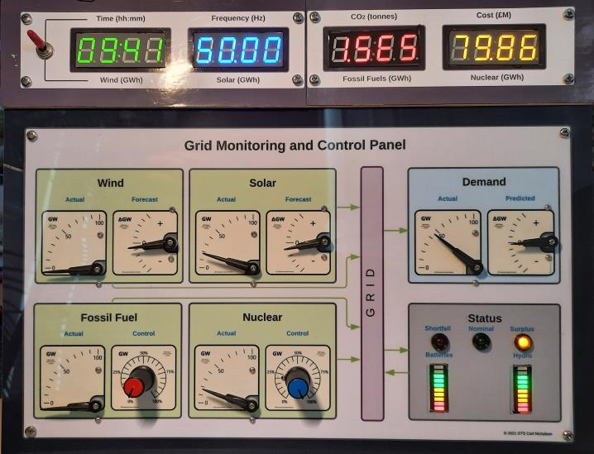
Monitoring and Control Panel
Numeric displays
Display selection
Power gauges
Forecast gauges
Control knobs
Grid status indicators
Storage status indicators
Notes:
Give a brief overview of the presentation. Describe the major focus of the presentation and why it is important.
Introduce each of the major topics.
To provide a road map for the audience, you can repeat this Overview slide throughout the presentation, highlighting the particular topic you will discuss next.

Slide 18
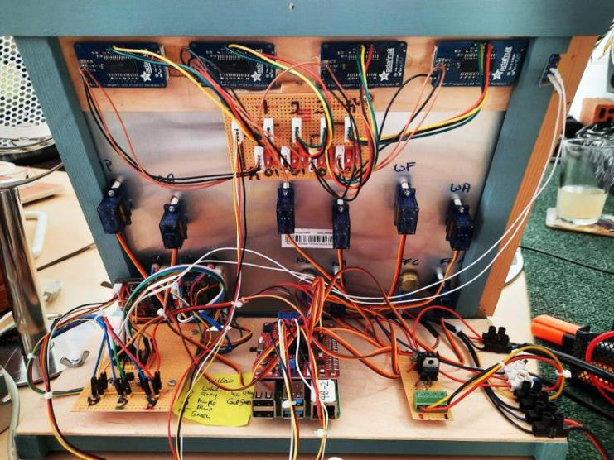
Monitoring and Control Panel
Notes:
Give a brief overview of the presentation. Describe the major focus of the presentation and why it is important.
Introduce each of the major topics.
To provide a road map for the audience, you can repeat this Overview slide throughout the presentation, highlighting the particular topic you will discuss next.

Slide 19
Difficulty levels
In game mode three difficulty levels are implemented:
easy
moderate and
hard
These affect the models in the following ways:
Weather (wind, sun) and consumer demand are more volatile
Forecasts are increasingly inaccurate
Storage capacity and power are reduced, making balancing the grid a more demanding task
Notes:
Give a brief overview of the presentation. Describe the major focus of the presentation and why it is important.
Introduce each of the major topics.
To provide a road map for the audience, you can repeat this Overview slide throughout the presentation, highlighting the particular topic you will discuss next.

Slide 20
Videos
Three videos show the system in operation:
Startup
Game play
Shutdown
Notes:
Give a brief overview of the presentation. Describe the major focus of the presentation and why it is important.
Introduce each of the major topics.
To provide a road map for the audience, you can repeat this Overview slide throughout the presentation, highlighting the particular topic you will discuss next.

Slide 21
Reporting
A report is generated at the end of each game containing:
Summary data
Game number, date and time
Total energy generated, used and stored
Overall utilisation of each controlled energy source
Total and average costs incurred and CO₂ produced
Comments & scores for the three sparks or Electrical “E”s:
Efficiency
Eco-friendliness
Economy
Sparks earned – a final judgment on overall performance:
Red spark - worst
Blue spark - intermediate
Green spark – best
Timeline plots – showing exactly what happened and when:
Scenario: the given conditions for wind, sun and consumer demand
Controls: how visitor controlled the Fossil Fuels and Nuclear power generation
Consequences: how the grid responded with energy storage and grid surplus/shortfall balance.
Reports and other game related data are stored locally and in the online database*.
*Created & maintained by Ben Winterleinweber – for which much thanks!
Notes:
Give a brief overview of the presentation. Describe the major focus of the presentation and why it is important.
Introduce each of the major topics.
To provide a road map for the audience, you can repeat this Overview slide throughout the presentation, highlighting the particular topic you will discuss next.

Slide 22
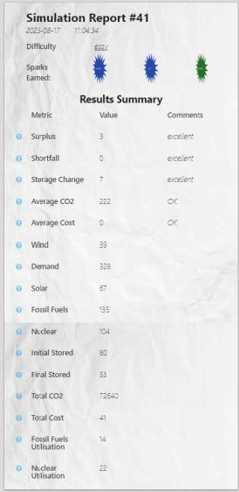
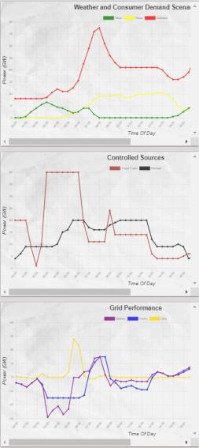
Simulation Report (online)
Notes:
Give a brief overview of the presentation. Describe the major focus of the presentation and why it is important.
Introduce each of the major topics.
To provide a road map for the audience, you can repeat this Overview slide throughout the presentation, highlighting the particular topic you will discuss next.

Slide 23
# Part II
print(“Greening the Spark”)
code_view = True
Notes:
Give a brief overview of the presentation. Describe the major focus of the presentation and why it is important.
Introduce each of the major topics.
To provide a road map for the audience, you can repeat this Overview slide throughout the presentation, highlighting the particular topic you will discuss next.

Slide 24
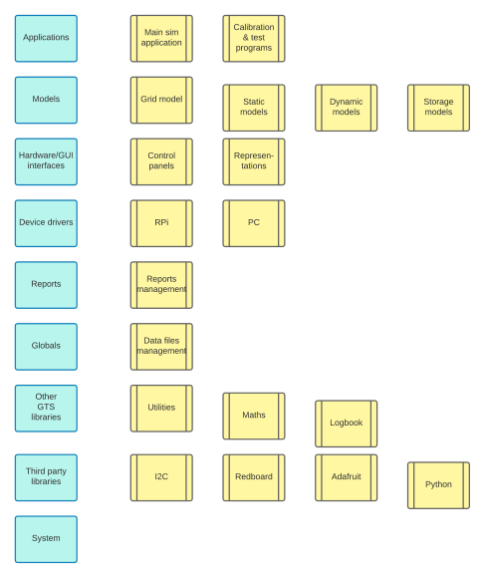
Software Architecture
Notes:
Give a brief overview of the presentation. Describe the major focus of the presentation and why it is important.
Introduce each of the major topics.
To provide a road map for the audience, you can repeat this Overview slide throughout the presentation, highlighting the particular topic you will discuss next.

Slide 25
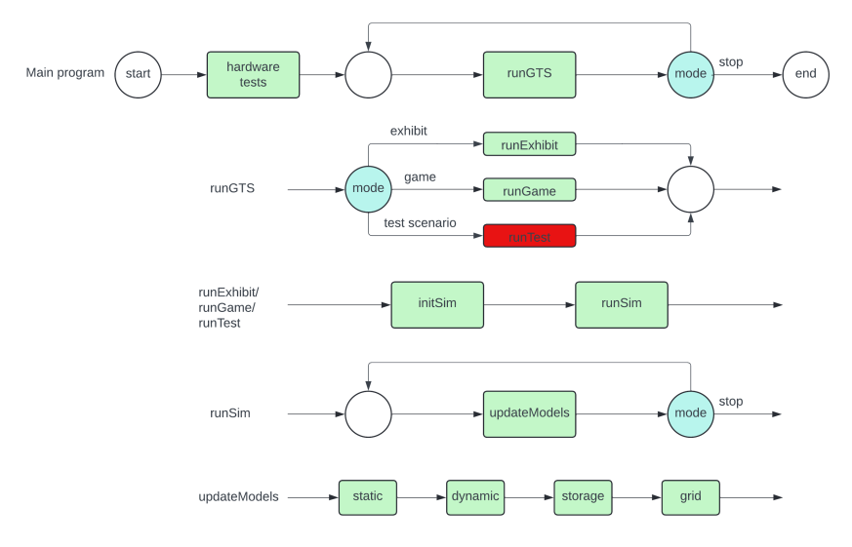
Main Simulator Application
Notes:
Give a brief overview of the presentation. Describe the major focus of the presentation and why it is important.
Introduce each of the major topics.
To provide a road map for the audience, you can repeat this Overview slide throughout the presentation, highlighting the particular topic you will discuss next.

Slide 26
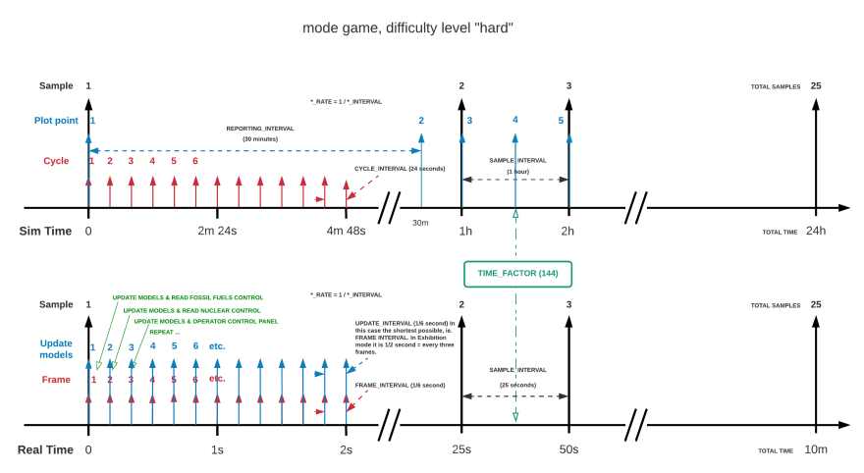
Simulation Time
Notes:
Give a brief overview of the presentation. Describe the major focus of the presentation and why it is important.
Introduce each of the major topics.
To provide a road map for the audience, you can repeat this Overview slide throughout the presentation, highlighting the particular topic you will discuss next.

Slide 27
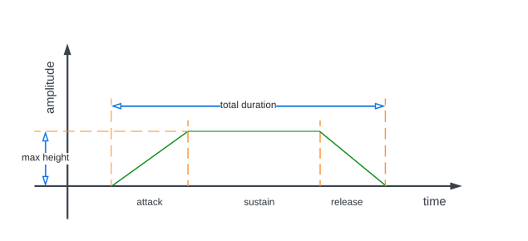
Bursts
Wind, sun & consumer demand change too slowly for young minds, as the timelines only contain one sample per hour. “Bursts” create short term variability in the form of:
gusts of wind,
clouds and
surges in consumer demand.
These are like randomly generated midi notes with start time, amplitude, attack, sustain and release parameters randomised to create bursts lasting in the order of tens of seconds. This feature is only run in exhibit mode, as games run much faster than real time and bursts wouldn’t get noticed.
Notes:
Give a brief overview of the presentation. Describe the major focus of the presentation and why it is important.
Introduce each of the major topics.
To provide a road map for the audience, you can repeat this Overview slide throughout the presentation, highlighting the particular topic you will discuss next.

Slide 28
Loop Iteration Classes
Utilities for running in endless loop:
Transition: detects when something changes, responds when due and unlocked (eg. movement detection, low storage)
Timer: set, run and stop (eg. game reactivation)
Scheduler: predefined, fixed & random repeat (eg. bursts)
Cycler: for cyclic function calls (eg. staggered ADC calls)
Toggler: toggles binary variable
Interlock: for managing shared resources (eg. representations)
Sampler: averages over a number of samples (eg. reports)
Bursts: short term events for static models (like midi)
Notes:
Give a brief overview of the presentation. Describe the major focus of the presentation and why it is important.
Introduce each of the major topics.
To provide a road map for the audience, you can repeat this Overview slide throughout the presentation, highlighting the particular topic you will discuss next.

Slide 29
Audio
Audio comprises sound effects, ambient sounds and speech. Three voices are implemented: a robotic system voice and two guides: an Aussie “bloke” (Logan) and a woman of Indian heritage (Sajani).
Playlist handler
Plays playlists and single audio files. These are managed in an Access database. 152 audio files, 20 predefined playlists, 1 calculated for game results.
Sequential, where the program stops until the list has finished playing, queued, where files are put in a queue and played in parallel with the program thread or in ambient mode, when audio files can play in parallel without being queued
Queue handling consists of two parts: adding a file to the queue and servicing the queue to play the next one when it comes due
Multi-version playlists can be called with a specific version, cyclic or random. This is to allow a variation in audio responses to common events.
Speech synthesis uses Google Cloud Services Text to Speech
Sound effects are largely courtesy of Freesound.
Post processing of the audio files is done in Ableton Live where necessary (eg. robotic GTS system voice) with the final editing being done in Goldwave.
Notes:
Give a brief overview of the presentation. Describe the major focus of the presentation and why it is important.
Introduce each of the major topics.
To provide a road map for the audience, you can repeat this Overview slide throughout the presentation, highlighting the particular topic you will discuss next.

Slide 30
Part III
Greening the Spark
The Future
Notes:
Give a brief overview of the presentation. Describe the major focus of the presentation and why it is important.
Introduce each of the major topics.
To provide a road map for the audience, you can repeat this Overview slide throughout the presentation, highlighting the particular topic you will discuss next.

Slide 31
Museums
“Greening the Spark” is for installation in hands-on science and technology museums / centres around the world. This requires:
Funding,
Teaming up with an established exhibit design and installation team and
Finding a target venue willing to host it.
Unfortunately, promotion and marketing are not my forte and efforts so far have come to nought!
There's a great marketing opportunity here for someone who likes a challenge and is willing to put more money into a project than they will get out - at least in the short term.
Philanthropists welcome…
I'm happy to demonstrate the project at my flat (near the i360, Brighton, UK) to anyone who's interested. Takes about 40 minutes, depending on the number of questions.
Notes:
Give a brief overview of the presentation. Describe the major focus of the presentation and why it is important.
Introduce each of the major topics.
To provide a road map for the audience, you can repeat this Overview slide throughout the presentation, highlighting the particular topic you will discuss next.

Slide 32
Development
Wish list for future innovations:
GUI control panels accessible over the internet
AI driven grid management
Better data visualisation
Modular hardware for expansion of control panels
Live streaming of real National Grid data
Notes:
Give a brief overview of the presentation. Describe the major focus of the presentation and why it is important.
Introduce each of the major topics.
To provide a road map for the audience, you can repeat this Overview slide throughout the presentation, highlighting the particular topic you will discuss next.

Slide 33
Schools and universities
“Greening the Spark” is provided as an open-source project acting as a blueprint for an interdisciplinary approach to system design, building and development.
Key selling points:
Modular open source hardware and software
Embraces design, modelling, gaming, spreadsheets, programming, IoT, electronics and mathematics
Encourages teamwork and innovation
Promotes energy costs and climate change awareness
Unlimited scope for development, including: new models & theming, remote access, live streaming of National Grid data, networking with other installations, GUI design, AI control, data analysis and presentation, 3D printing etc.
Notes:
Give a brief overview of the presentation. Describe the major focus of the presentation and why it is important.
Introduce each of the major topics.
To provide a road map for the audience, you can repeat this Overview slide throughout the presentation, highlighting the particular topic you will discuss next.

Slide 34
Websites
Greening the Spark Online results
https://www.greening-the-spark.com/ https://gts-app-5fdd78ff9026.herokuapp.com/
Notes:
Give a brief overview of the presentation. Describe the major focus of the presentation and why it is important.
Introduce each of the major topics.
To provide a road map for the audience, you can repeat this Overview slide throughout the presentation, highlighting the particular topic you will discuss next.

Slide 35
Publications
Hackspace Magazine:
Six page spread in the Raspberry Pi publication “HackSpace” magazine – pages 32-37, issue #65, April 2023.
https://www.greening-the-spark.com/2023/04/03/hackspace-does-gts/
MagPi Magazine:
Two page feature – more like an interview really.
Pages 22-23, issue #129, May 2023.
https://www.greening-the-spark.com/2023/05/14/magpi-does-gts/
Notes:
Give a brief overview of the presentation. Describe the major focus of the presentation and why it is important.
Introduce each of the major topics.
To provide a road map for the audience, you can repeat this Overview slide throughout the presentation, highlighting the particular topic you will discuss next.

